Slide 1

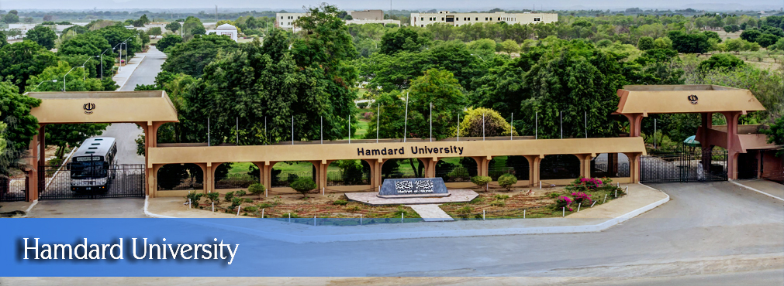
FYP
Proposal
AL-SasdasdasdasAFFAR
Group Members:
MUHAMMAD KHAWER ALI
BSCS/F15/0110
…………………………….
MUHAMMAD SHAHZAIB WALEED
BSCS/F16/0135
…………………………….
USMAN JAVED
BSCS/F15/1277
Supervisor:
IQBALUDDIN KHAN
Hamdard University

Slide 2
Overview
Group Introduction
Problem Statement
Objectives
Motivation
Literature Review
Scope
Use Case Diagram
Methodology
Project Plan
Budget / Costing
Project tools
Deliverables
References

Slide 3
Group Introduction
Project Partners:
Muhammad Khawer Ali
Muhammad Shahzaib Waleed
Usman Javed
Supervisor:
Iqbaluddin Khan (ASST. PROFESSOR)
Mr. Afzal Hussain is generous person with highly cooperative attitude. His knowledge is commendable not only on his field but also in general.

Slide 4
Problem Statement
Poor quality of public transport
Lack of better options
Difficult process of booking rides
Need to haggle for better rates
Unregulated business practices by drivers

Slide 5
Problem Statement
Objectives:
Develop an Application for booking vans
Seamless execution with cheapest rates possible
Simplify acquisition of money for drivers and vehicle owners
Motivation:
Need a better way to book vehicles
Need to decrease the cost of travel
Improved quality of travel

Slide 6
Project Scope
Scope:
The software application being produced is called "Van Booking Service System" or VBSS which is a mobile application that can manage user accounts and driver accounts from a single interface. The name of this Van Booking Service application is proposed "AL-SAFFAR".
The aim is to automate the van booking service concept and for this, an android application will be developed for customers interested in booking a van for a specific route on monthly basis. This our VBSS service will be functional 24/7, the rides booked would be tracked so the transportation would be reliable and secure as well. Allowing customers to book rides on cheap fares is another focus of this system.
This system will allow users to execute different procedures as bookers and drivers. The system provides the customer, a one tap solution on their mobile devices through which you can book a van for the route they want to go to on the monthly bases, and the whole procedure includes the map fragment through which the person will be able to select. After confirming it will then show the customers the driver list and then the user will select the preferred payment method.
The driver, after logging in as a driver will be shown the booking list. Moreover, it improves the efficiency of work, lessen the processing time, and manage all those extra tasks through the application (find a driver manually for a specific route or drivers finding people to drive them to their destination for making some money) which may take lots of efforts and time.

Slide 7
Project Scope
Functional Requirements :
Bookers:
Login
Select route
Check available drivers
Book vehicle
Chat with drivers
Confirm booking
View location of driver at the time of service
Give rating
Drivers:
Login
Check routes
Check bookings
Chat with customers
Send notifications while in service
Receive ratings

Slide 8
Project Scope
Non-Functional Requirements :
Efficiency
Effectiveness
Reliability
Security
Response time
Supportability

Slide 9
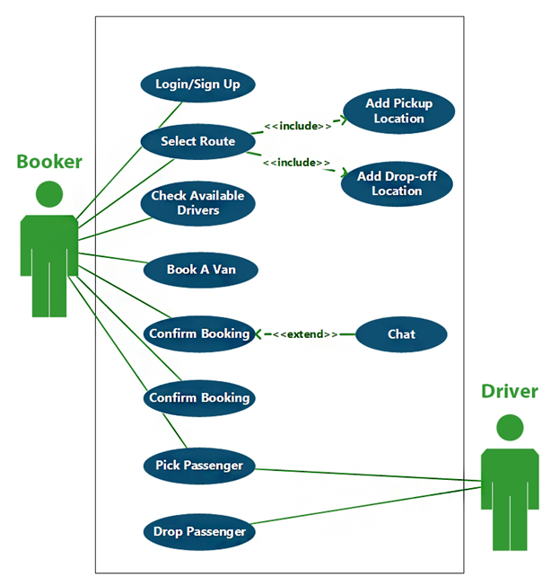
Use Case Diagram

Slide 10
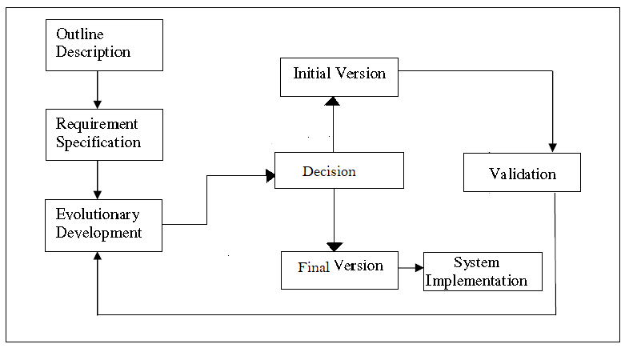
Methodology
Evolutionary prototype

Slide 11
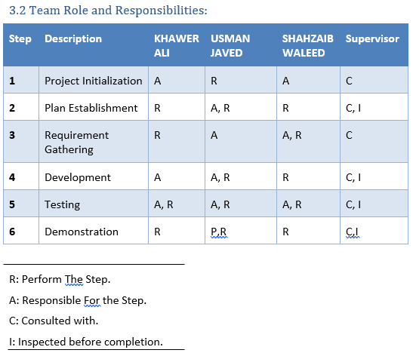
Project Plan

Slide 12
Project tools
Software:
Google Firebase
Android Studio

Slide 13
Project tools
Hardware:
None required

Slide 14
Budget / Costing
No financial cost is required to build this system.

Slide 15
Deliverables
First Evaluation:
Design Documents (ERD, flow charts, layouts, UI/UX design)
Functional database
Connectivity of Android Application with database along with testing of some backend code
Final Evaluation:
Fully functional system as per scope
Final Year Project Report
Source Code in CD

Slide 16
Thank You!

